Slide 1
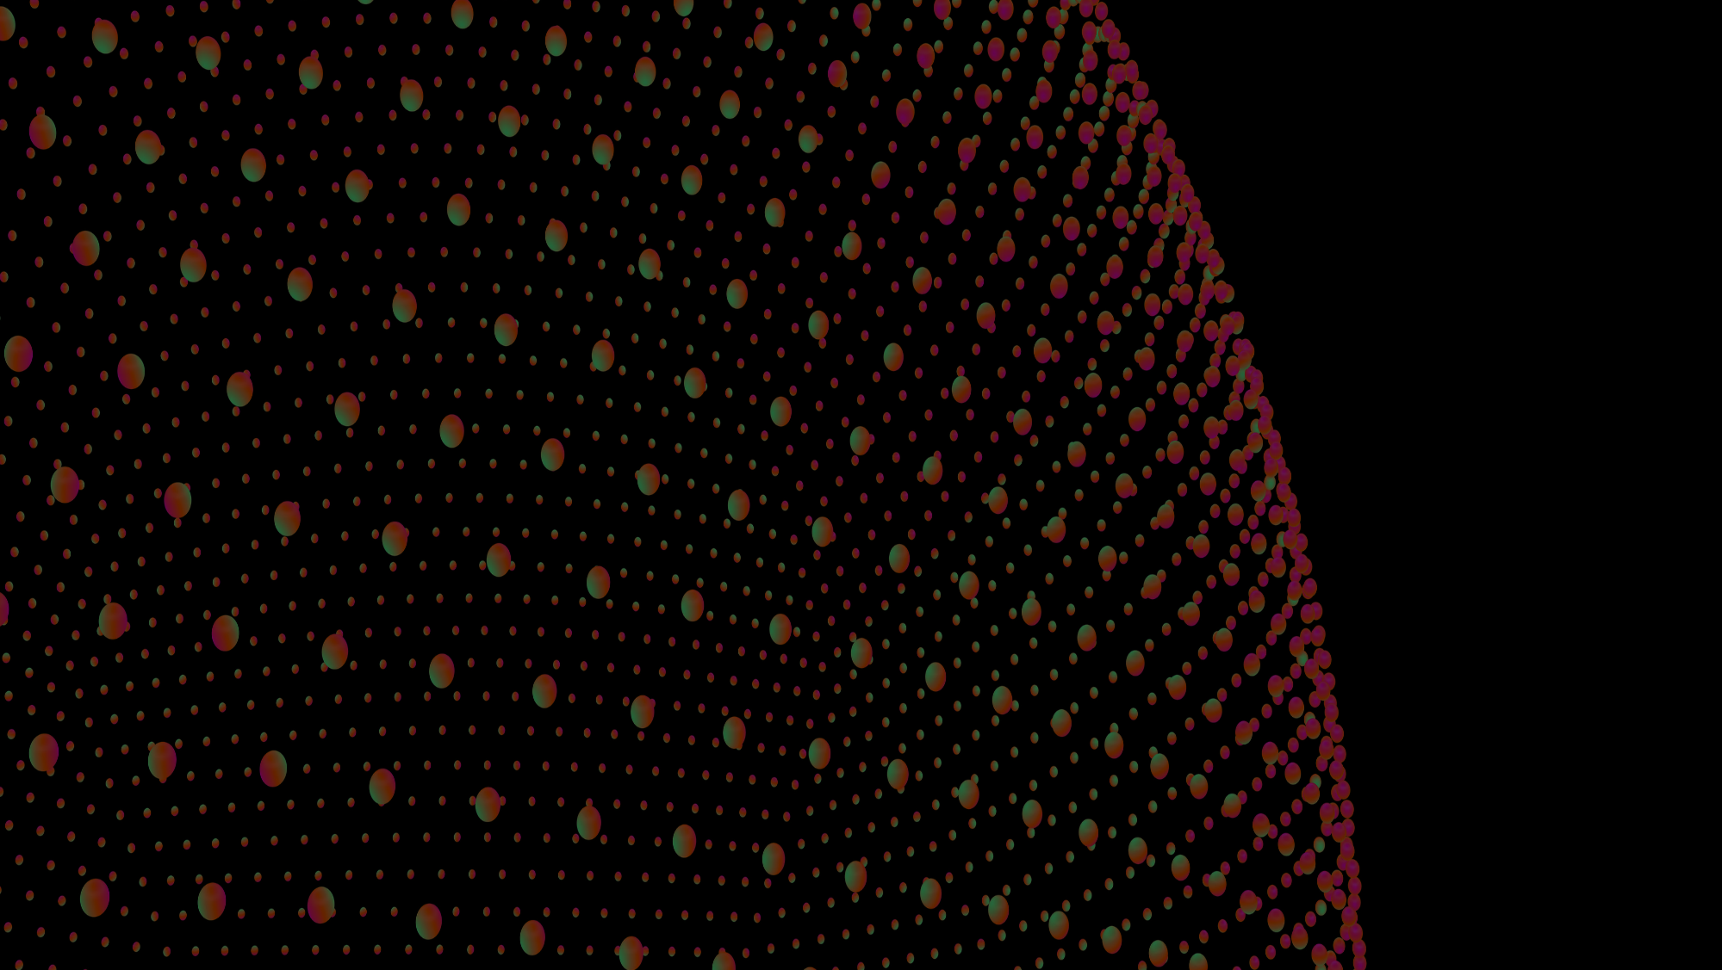
Human Stress Detection and Prediction
Presented By: Kaustubh Desale

Slide 2
Introduction
In today's fast-paced world, stress is a major issue impacting health.
Sleep is essential for recovery, but stress can disrupt it, leading to health issues.
The project “Human Stress Detection and Prediction Using ANN” aims to predict stress levels during sleep using physiological data.
An Artificial Neural Network (ANN) is used to analyze sleep metrics and classify stress levels as "Stressed" or "Not Stressed."
Purpose: Help users identify hidden stressors during sleep and take preventive steps for well-being.

Slide 3

Problem Statement and Solution
Problem Statement:
Chronic stress during sleep can lead to health issues (e.g., cardiovascular problems, cognitive decline).
Most people are unaware of their stress levels during sleep.
Physiological markers like heart rate and respiratory rate provide insights into stress but require advanced interpretation.
Solution:
Using an ANN-based system to analyze physiological data and detect stress levels.
Binary classification: "1" for stressed and "0" for not stressed.
Goal: Enable early detection of stress patterns and support proactive stress management.

Slide 4

Dataset Used
The Dataset contains 8 input parameters:
Snoring Rate: Snoring range of the user.
Respiratory Rate: Breathing rate recorded during sleep.
Body Temperature: Temperature of the body while sleeping.
Limb Movement: Movement of limbs during sleep, indicating restlessness.
Blood Oxygen Levels: Level of oxygen in the blood, affecting sleep quality.
Eye Movement: Eye movements associated with REM sleep stages.
Sleeping Hours: Total hours of sleep.
Heart Rate: Pulse rate, impacting stress levels.
Stress Level: 0 – “NO STRESS”, 1 – “STRESS”.

Slide 5

USER INTERFACE (UI):
SignUp Page

Slide 6
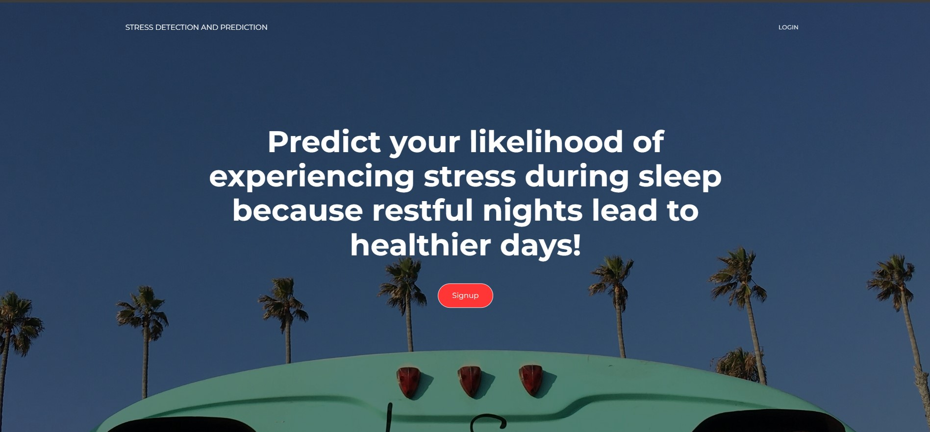
AboutUs Page

Slide 7
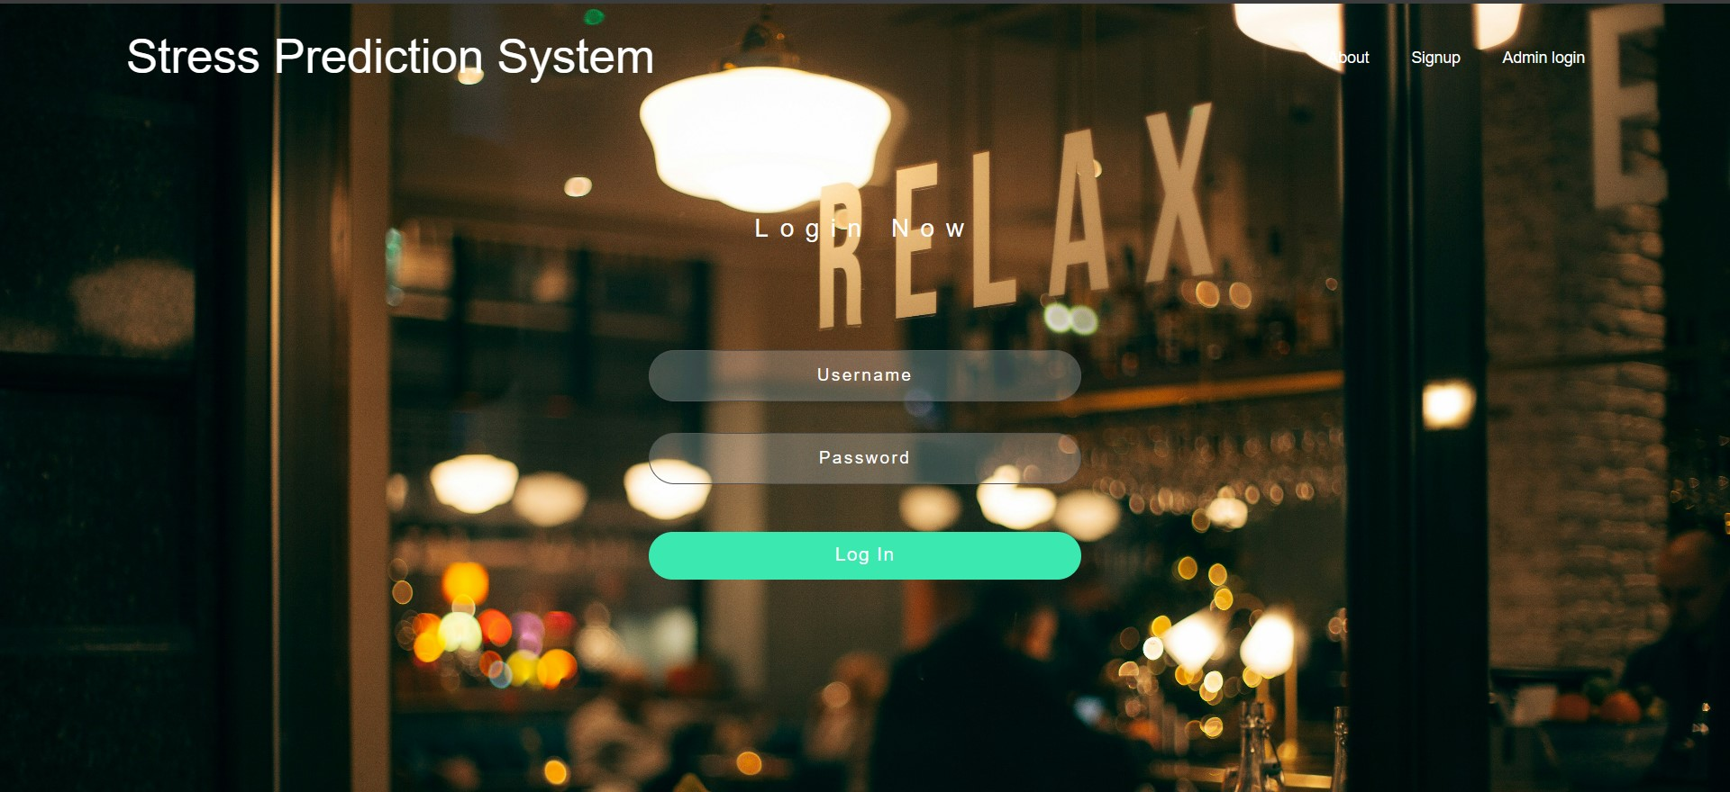
Login Page

Slide 8
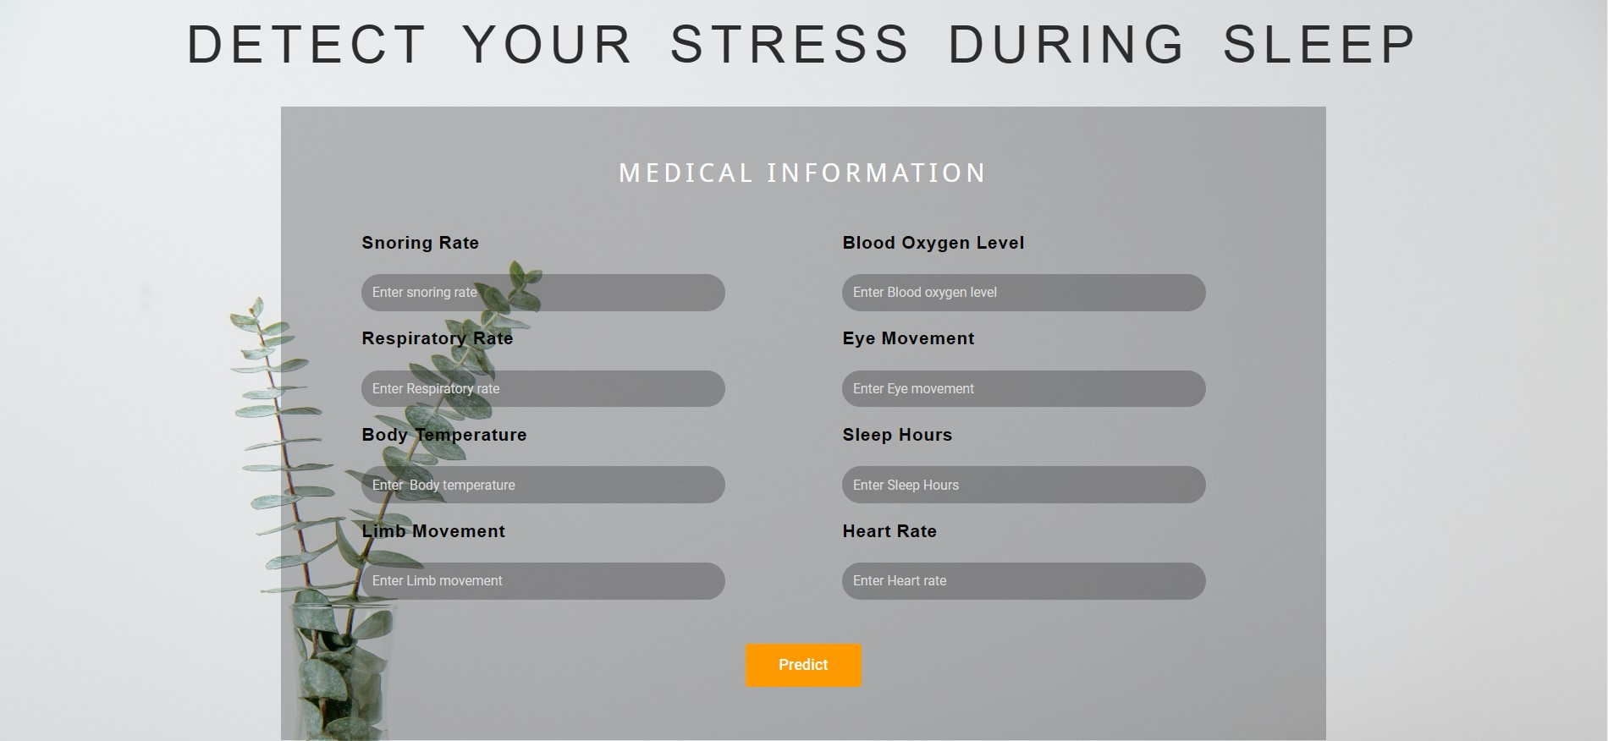
Prediction Page

Slide 9
Conclusion:
Effective Stress Detection System: The project successfully demonstrates the potential for using physiological data collected during sleep to detect human stress levels. By leveraging an Artificial Neural Network, we provide a systematic approach to analyze and classify sleep data as either "Stressed" or "Not Stressed."
Applications and Future Potential: This project opens avenues for real-world applications, particularly in healthcare and wellness. Future work could expand on the deployment aspect, integrating this system into wearable health devices or mobile applications, enabling continuous monitoring and proactive intervention.

